Slide 1
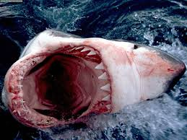
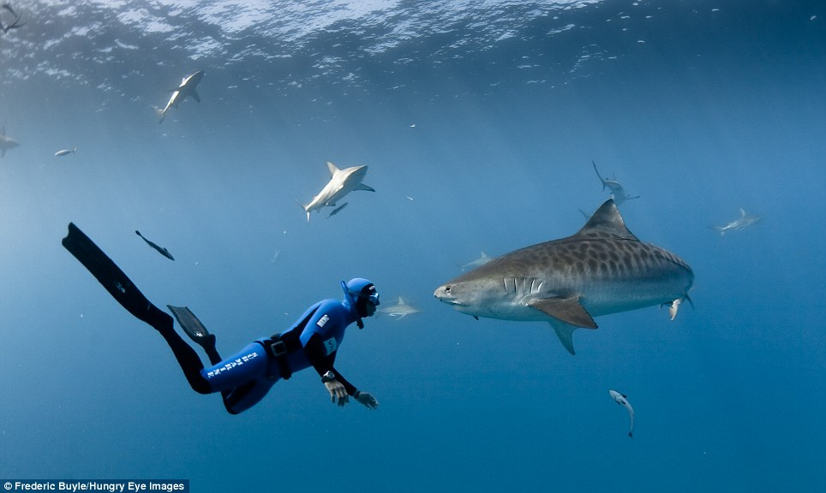

Slide 2
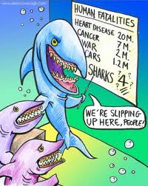
A story about……..?
Notes:
Remember that shark attacks are only a very very small proportion of deaths in Australia

Slide 3
WA was deemed "shark attack capital of the world" following five fatal shark attacks in the past 19 months.
MALCOLM HOLLAND , SCIENCE REPORTER THE DAILY TELEGRAPH JULY 19, 2013 8:35AM
Notes:
We want to consider a recent science focused story in the media, and this is a little controversial. We are seeking to get the students to consider the statements that are made in the media and question comments.

Slide 4
So sharks are attacking in WA!
Who says we are the shark capital?
Are we the shark attack capital of the world?
Why are sharks attacking
How can we protect ourselves?
Notes:
Taking this idea further, we are concerned as Australians in the hot weather that we can no longer take to the water for a cooling dip without considering the risk of a shark attack and so there are plenty of alternatives that have come on to the market often at a large cost.

Slide 5
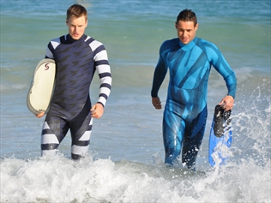
Shark Mitigation Systems
Notes:
AUSTRALIAN shark expert Valerie Taylor wore a chain link body suit over her wetsuit to protect herself while filming feared ocean predators.
Now, an Aussie company has invented wetsuits which, it claims, are a breakthrough in protecting surfers, swimmers and divers from sharks.
Previous anti-shark devices - like the Shark Shield - rely on electrical impulses to ward off sharks. But West Australian-based company Shark Mitigation Systems says its combination of colours and patterns on the wetsuits "disrupt the visual perception of sharks".
The patterns and colours have also been printed on stickers that can be fitted to the bottom of surfboards.
"One design allows the wearer to effectively blend with background colours in the water, making it very difficult for a predatory shark to detect or focus," company spokesman Hamish Jolly said. "The second design makes the user appear highly visible while using disruptive colour patterns that are totally unlike normal prey."
Mr Jolly said the disruptive patterned wetsuits and stickers confused sharks in the last few seconds before an attack when sharks relied on their eyes to target their prey.
The designs and colours were created in a collaboration between the company and the University of Western Australia's Oceans Institute.
WA was deemed "shark attack capital of the world" following five fatal shark attacks in the past 19 months. The company said the system was licensed to innovative Australian wetsuit company Radiator.
"The initial results of our testing have been quite extraordinary and given us the confidence to release this range of suits," Mr Jolly said.
"However, we envisage testing will be ongoing over many years. We can't say our suits are a failsafe protection against attack but we believe they certainly can assist."

Slide 6
West Australian-based company Shark Mitigation Systems says its combination of colours and patterns on the wetsuits "disrupt the visual perception of sharks".
How do we know that this works?
Can sharks see colour ?
Do they rely on vision or smell or …????
Notes:
So will the sharks still see the swimmer in the water in these cool looking wetsuits? Do sharks find us using smell or do they use other senses to track their pray.

Slide 7
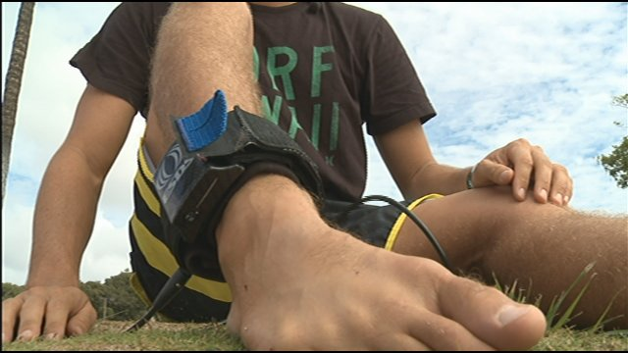
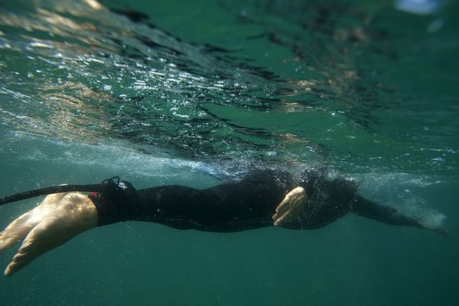
$479
Notes:
With expensive devices like this one – do they work??

Slide 8
‘Electronic Shark Defence System is a device that repels sharks. (ESDS) emits an electric pulse that repels sharks by affecting the gel in a shark’s nose’
‘Shark Shield was invented by the South African Government through the Natal Shark Board, home to some of the sharkiest waters in the world’
http://www.sharkprotection.com.au
Notes:
Shark Shield was invented by the South African Government through the Natal Shark Board, home to some of the sharkiest waters in the world. It is used by the Australian Elite Military, the South African Navy the US Coast Guard and is also approved by NATO.
So they make up words ‘sharkiest’

Slide 9
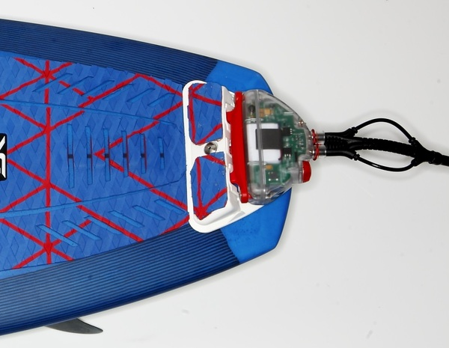
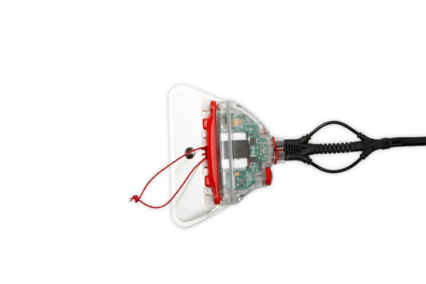
Notes:
Another shark repellent device

Slide 10
How do we know that this works?
Will it just be an expensive way to piss
off a shark?
What about this dangerous shark…????

Slide 11
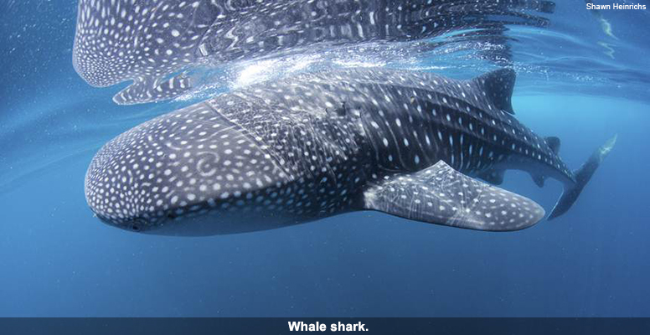
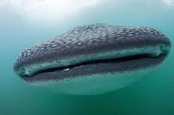
Notes:
This is a whale shark and they are no dangerous they have no teeth http://www.whaleshark.org/ see this site for more details and also there is a great TED talk http://talentsearch.ted.com/video/Brad-Norman-A-deep-dive-into-th.

Slide 12
So the whale shark is harmless!
Can we look to Hollywood for our stories?
Notes:
So how do we find ‘reliable’ data can we look to any information that we just google?

Slide 13
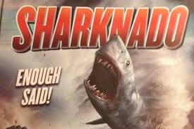
Stories???
http://www.youtube.com/watch?v=iwsqFR5bh6Q

Slide 14
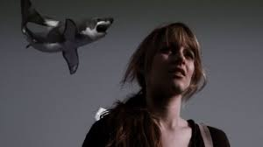

Slide 15
What about research?
What do we want to know?
How can we find out?
Notes:
Obviously some data as not reliable and is a little ridiculous, but how will children know this? We need to know where to find reliable information and to be able to critique websites and the information offered….to be more scientifically literate

Slide 16
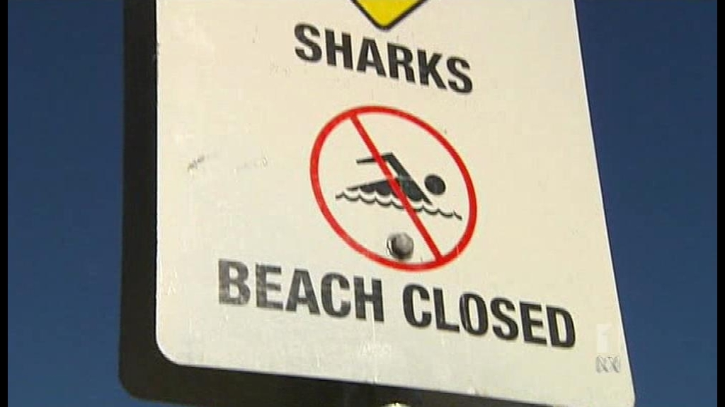
Research?
http://www.abc.net.au/lateline/content/2012/s3488350.htm
Notes:
http://www.abc.net.au/lateline/content/2012/s3488350.htm this video starts to consider the data that is available.

Slide 17
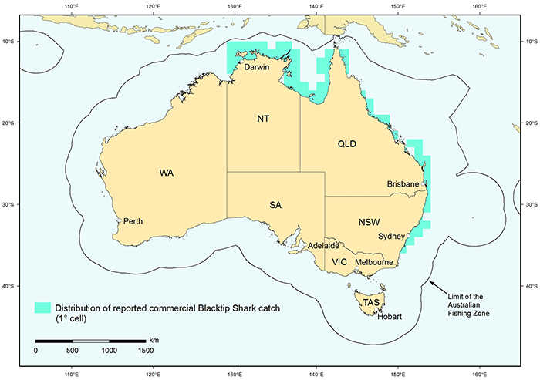

Slide 18
Is this just what sharks are designed to do?
Should we stay out of the water?
Notes:
So here is just one problem that can form the basis of your investigation. What is it that you want to know about the world. You don’t need to concentrate on the marine environment you can consider any environmental issue, problem or question.

Slide 19
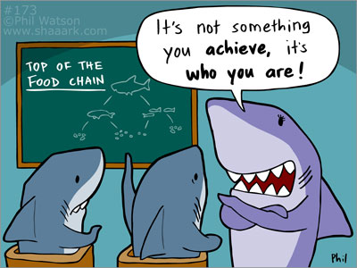

Slide 20
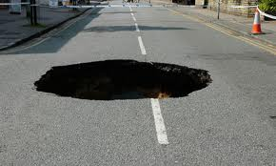
Avoiding pitfalls
Questions???
Avoiding pitfalls
Notes:
We apologise in advance for any and all problems as this is a brand new unit it will have teething problems and so we hope that you will email us with any problems you encounter and we endeavour to fix any and all problems as soon as we can. Please be patient and thank you in advance

Slide 21
Your mission………..

