Slide 1
Dilemma
Week 2
What do we know
Why
Science
Sustainability
Problem
Why is this so?
Environment
Notes:
Why do we need science? This week the focus is on science investigation and why we need to engage with science and science issues.
By the end of this week you need to be developing an area of interest and starting to think about a problem that you are going to study. From there we are going to produce a problem statement and also a concept map of as many linked areas as possible.

Slide 2
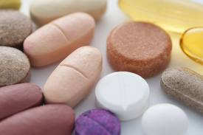
Why do we need inquiry??
Why do we need science knowledge?
Notes:
Now we are working in groups on either the investigation or the dilemma and once we finish those we can swap over and complete the other.
Or http://www.youtube.com/watch?v=ZfdtKY2_rU0

Slide 3
Workshop 2 Tasks
1) Inquiry in action 1. Complete the investigation exactly as outlined and answer the questions.
2) Read the science stories of inquiry that have been included. Summarize each briefly, identifying the aspects of the inquiry process and consider the questions asked.
3) Use the newspaper and other sources to identify an article about water that you may want to investigate
Notes:
Post you completed investigation in the Weekly Task Journal. Post your answer about paper towels to the Discussion
At the end of the session we are going to look at collaboration (working together) and also unpacking assessment 1.

Slide 4
Working Together
There are 2 ways to collaborate
1) Partnerships - you may choose to work with a partner on the project
2) Support and Critique Group - you will be expected to have your project considered by your peer support group and you will participate in the support group to help others refine their project.
Week 3, Week 6 and week 10
Notes:
This is on the website in the section working together on the website

Slide 5
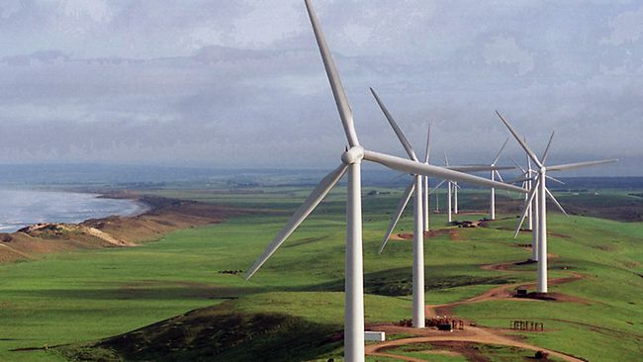
Problems in the Environment
Notes:
Here are 2 examples to get you thinking about the world and what you would like to know

Slide 6
Environment Protection Authority finds wind farms do not produce harmful noise
LOW level noise produced by wind turbines has an insignificant impact on neighbouring properties and is no greater than from other sources, a report from the state's Environment Protection Authority says.
In a study that will add to the debate between wind farm proponents and detractors, the EPA's Infrasound levels near wind farms and in other environments report measured the level of infrasound at 11 urban and rural locations around South Australia, including adjacent to the Bluff and Clements Gap wind farms
Source AdelaideNow

Slide 7
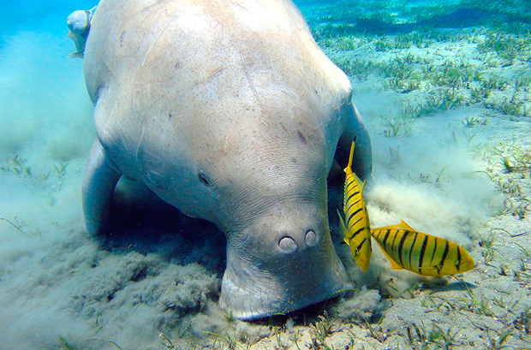
Why Are Dugongs Dying?
http://www.abc.net.au/science/articles/2013/04/15/3727295.htm
Notes:
http://www.abc.net.au/science/articles/2013/04/15/3727295.htm

Slide 8
Why Are Dugongs Dying?
Dugongs (Dugong dugon) are a member of a small group of aquatic mammals called sirenia -- or sea cows –
Dugongs in one of Australia's largest populations appear to be getting sick and dying as a result of exposure to cold water, say researchers (who).
How do they know? Where is the evidence?
The findings are reported in a recent issue of the journal Diseases of Aquatic Organisms.
that don't like cold water, says marine epidemiologist, Dr Mark Flint, of the University of Queensland.
Notes:
The findings are reported in a recent issue of the journal Diseases of Aquatic Organisms.
that don't like cold water, says marine epidemiologist, Dr Mark Flint, of the University of Queensland.

Slide 9
In the US, the closely related endangered manatees Trichechus manatus have been dying from a condition known as cold stress syndrome (CSS), which occurs when the animal is exposed to water temperatures lower than 17 or 18°C.
The animals' skin becomes cracked and susceptible to infections and they can die.(researched on manatees suffering CSS in Florida.) Evidence based data
Animals with chronic CSS can die in weeks, during which time they lose weight.
Notes:
In the US, the closely related endangered manatees Trichechus manatus is known to gather around warm water that comes out of power plants when it gets cold.
In the past decade, manatees in Florida have been dying from a condition known as cold stress syndrome (CSS), which occurs when the animal is exposed to water temperatures lower than 17 or 18°C. The animals' skin becomes cracked and susceptible to opportunistic infections and they can die within a few days, says Flint, who has worked on manatees suffering CSS in Florida.
Animals with chronic CSS can die after several weeks, during which time they lose weight and their body fat atrophies.

Slide 10
Assessment 1 Unpacked
This will be completed in tute next week
1) You need to identify a problem/issue/idea/notion/thought related to the environment that interests you and makes you think ….I wonder why
2) Your concept map – all the Q’s, areas of connectedness that you see as being related. This should be a detailed brain storm.
Notes:
I need an idea??? Well watch all the videos on the site, read all the attached links
Nuclear Power
Whaling
Whale sharks migration
Lobster pots vs sharks – who is winning?
Salinity
Extinction
Heavy metals
Climate change
Fire

