Slide 1
Week 5 Websites and Creative Commons

Slide 2
Tasks
1) Use 2 search engines and search the same phrase related to your investigation to determine what different sites are presented to you. 2) Evaluate the 3 websites on the scoop.it site using the rubric provided and determine which sites contain reliable material and why you think it is reliable.

Slide 3
Website evaluation

Slide 4
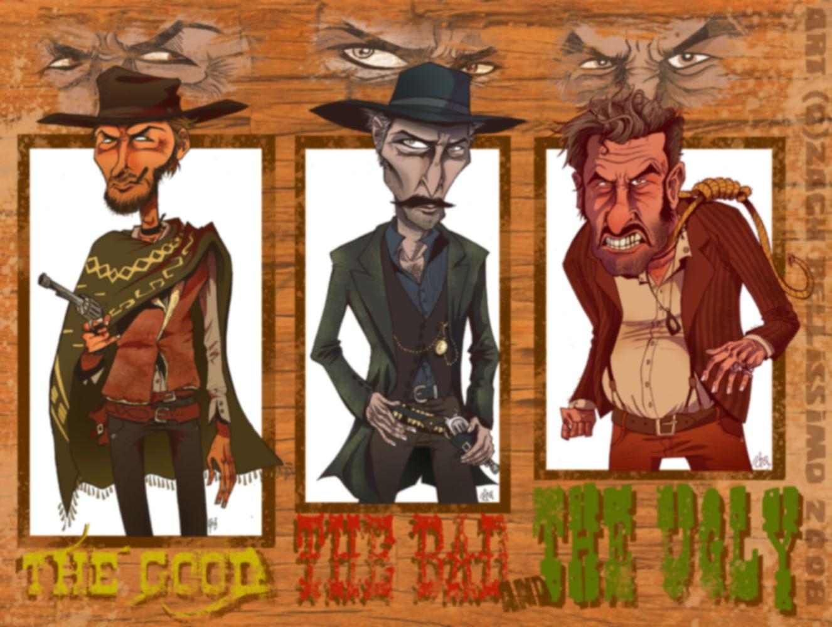
Not Google! Quick Draw
http://www.mashpedia.com
http://www.instagrok.com/
http://www.boolify.org/
https://duckduckgo.com/

Slide 5
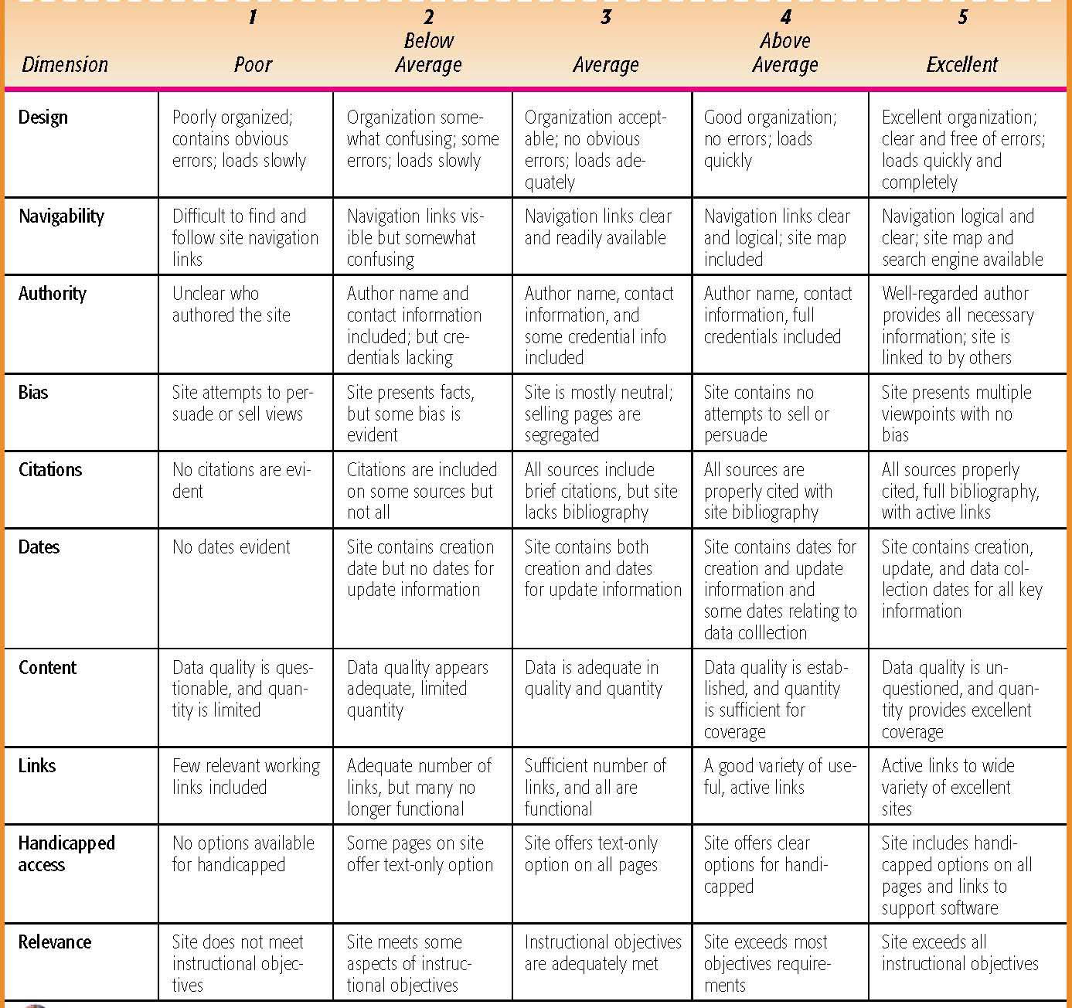
Tasks

Slide 6
Tasks
A Web page should be designed for easy navigation. Links should be easy to identify and grouped in some type of logical order. Students should be able to tell at first glance how a site is organized and the options available. An added bonus is the inclusion of a keyword search function.

Slide 7
Tasks
Authority
Some filters we can employ are:
• Is the author a well-regarded name you recognize?
• Does the online document contain a biography and an email address?
• Did you link to this site from a site you trust?
• Are you led to additional information about the author?
Notes:
Authority When we look at Internet information with a critical eye, we want to know the basis of the author’s a u t h o r i t y. Some filters we can employ are:
• Is the author a well-regarded name you recognize?
• Does the online document contain a biography and
an email address?
• Did you link to this site from a site you trust?
• Are you led to additional information about the author?

Slide 8
Tasks
Biased sites contain words that try to persuade rather than inform. Some of these words include over- generalisations and simplifications and may also contain games, giveaways, contests, or celebrity endorsements intended to persuade.
• Is it clear what organization is sponsoring the page?
• Is there is a link to the sponsoring organisation’s Web site?
• Is the page actually an ad disguised as information?
Notes:
Biased sites contain words that try to persuade rather
than inform. Some of these words include over- g e n e r a l i z a t i o n s and simplifications and may also contain games, giveaways,
contests, or celebrity endorsements intended to persuade.
• Is it clear what organization is sponsoring the page?
• Is there is a link to the sponsoring org a n i z a t i o n ’s Web site?
• Is the page actually an ad disguised as information?

Slide 9
Tasks
If the author of a site includes a source bibliography students can consult these sources to find additional information about the topic and compare the author’s content with other works. If the author leads the user to related sources, it allows the student to evaluate the
a u t h o r’s scholarship. Citations should be full citations to
allow students to locate the book or periodical at the library
Notes:
w i t h
other works. If the
author leads the user to related
sources, it allows the student to evaluate the
a u t h o r’s scholarship. Citations should be full citations to
allow students to locate the book or periodical at the library

Slide 10
Tasks
Every credible Web site includes the date that it was
created and the date of last update. Another date that may be
important to your students is the date the data was collected.
Students need to ask themselves if the information they are
looking for is from an area that demands more current
information. In this case, the date of last update is an important
feature to look for.

Slide 11
Tasks
Students need to realize some of the sources of misinformation on the Net, which include the fact there is nothing to stop a Web page author from modifying the text at any time; the use of opinion verbs and appeals to emotion may indicate bias; and there are many jokes and pranks on the Net.

Slide 12
Tasks
Students should also try to find out if a site is meant to be comprehensive in scope or is just an overview or sampler of links. The links should be appropriate for the site’s intended audience and also offer something that is not available at any
other online destination.

Slide 13
Tasks
Visually impaired users may utilize a screen reader to read the Web page, and it is important that there be text available and text alternatives for the graphics software to “read.”

Slide 14
Tasks
Central to the online research model is the need for students to know when to disregard information. With the amount of information available, it is imperative that students
learn how to evaluate whether the information that they find is pertinent to their purpose. This begins by having students clarify their objectives before they begin the research process.

Slide 15
Creative Commons does not mean a free for all.
http://www.youtube.com/watch?v=1DKm96Ftfko
Notes:
http://www.youtube.com/watch?v=1DKm96Ftfko
Still need to reference and need to
Advanced searches on google

Slide 16
Creative Commons Licenses

