Slide 1
How to spot bad graphs
Created by Paul Turner

Slide 2
Reasonable Numbers
Reasonable Scale
Tight scale expands changes
Makes small things appear big
Bigger scale contacts changes
Makes a big change appear small
Consistent
Is it the same measurement all the way along?
Does that measurement make sense?

Slide 3
Why is this a bad graph?
7 Days
53 days
12 days
26 days
Notes:
Looks very serious, very official.
(The answer is that the horizontal scale is very inconsistent. It looks like it is giving you a consistent timeframe (x axis), but it actually changes a lot along the bottom.

Slide 4
An extreme example
Notes:
This is measurements of the Swan river over a 12 hour period. This looks like a massive change at first glance. Big changes between the low and high point. But remember to always check the vertical scale.
The vertical scale is only covering 0.9 of a degree, so a very small temperature range.

Slide 5
An extreme example
Notes:
This is the same information on a graph with a different scale. Now it seems very flat.

Slide 6
Confusing Images
Animals Treated at the local veterinarian
Notes:
This is just plain confusing, and is often done by political parties or current affairs programs. Is it 5 dogs and 3 horses? But the horses are so much bigger. Was there more horses?

Slide 7
Context
Why was this information put together?
Was it created from a particular viewpoint, or to prove a particular point?
Political Parties
Bad science
What was the source of the information?
Notes:
Context of information matters

Slide 8
What is misleading about this?
Image Source: http://cloudfront.mediamatters.org
Notes:
Created by someone with an agenda. Wanted to show that the unemployment went up during the Obama administration
The vertical scale is misleading – Only shows between 8-10% unemployment. Very tight range. Makes comparatively small changes look much bigger.
Also, this is in the end of his presidential period (2008-2012)– There is no reason why this would be relevant.
(Also, the last data point is just plotted completely incorrectly. 8.6% should be way down the bottom)

Slide 9
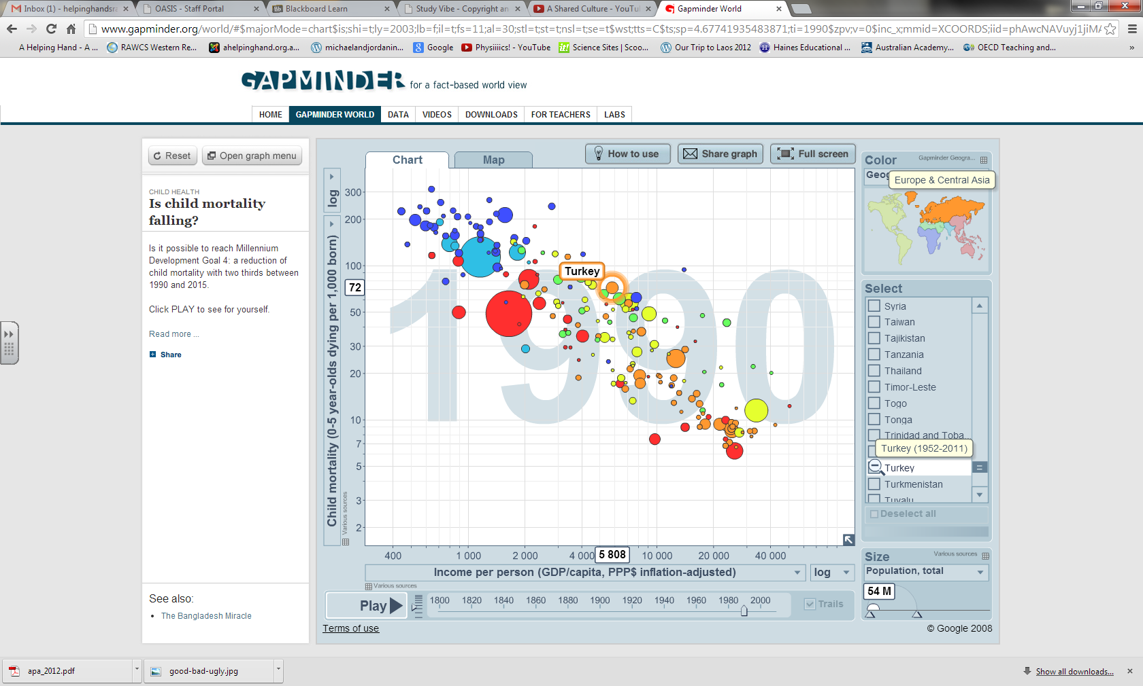
Notes:
http://www.gapminder.org/ Paul and I find this incredible but a little complex. Have a little look for example examine the graph of child mortality. Have a look at the changes in mortality over time, choose 1 or 2 countries and watch (use PLAY button) the changes over the years.

Slide 10
Notes:
http://www.futuretimeline.net/subject/energy-environment.htm#amazon-rainforest
Predictive trends this has lots of graphs that show predictive trends. These will only be useful if nothing changes to the context

Slide 11
Poodwaddle
Notes:
http://www.poodwaddle.com/Stats/ just a look, not sure if you could use this.

