Slide 1
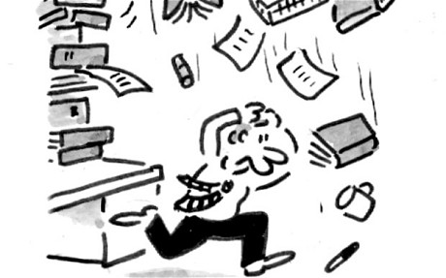
Curating
transitive verb to organize and choose the items in an exhibition at a museum or gallery
transitive verb to organize and choose the items in a digital repository

Slide 2
Tasks
3) Examine a range of content curation tools , select one to store and organise your collected information
4) Continue to generate a reference list using End note to capture and display your references correctly.
2) Examine data that contains qualitative and/or quantitative information and consider the limitations and advantages of each.
1) Inquiry in Action 3. Design and complete the investigation as outlined and answer the questions. .

Slide 3
Task. Examine a range of content curation tools, select one to store and organise your collected information
Notes:
We can put these up for students to see them – so links can be put up on BB so the others can see them or in class we can get them up for the others to follow

Slide 4
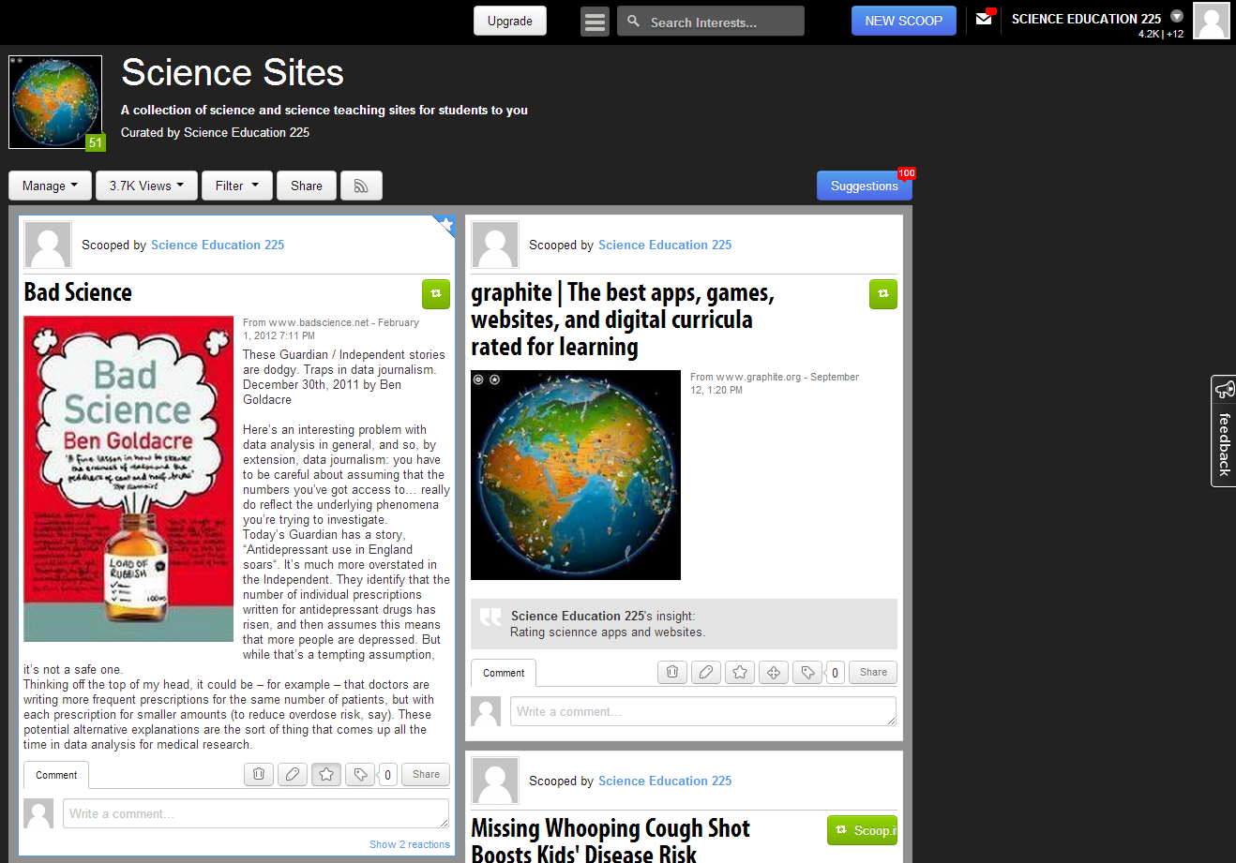
Notes:
Create your own scoop.it site or use another tool
http://www.scoop.it/t/science-sites

