Slide 1
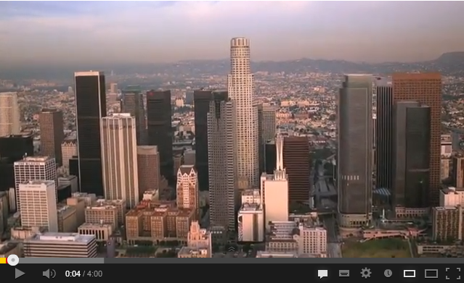
Week 3
http://www.youtube.com/watch?feature=player_embedded&v=GLgh9h2ePYw
Notes:
This image links to a mocumentary on plastic bags
It is time to find your project the issue you would like to research

Slide 2
Tasks
1) Explore how emotional bias will affect research and/or proposals around this issue. To do this choose 1 website on the emotions page (bag the web) and highlight use of emotive imagery and language and explain how this helps to create their message.
2) Use 1 mind mapping tools and 1 graphic organizer tools to explore 2 topics (1 tool type for each topic).
3) Create a Voki about the topic you have chosen. In 75 words explain what problem you have chosen. The Voki should identify the problem and why you have chosen it (this will form the beginning of your rationale).
4) Time to support your peers and perform a critique. Present your data to your group and get critical feedback. Critique and Support - Questions and Instructions here.
Notes:
So we are going to interrogate the websites on the ‘bag the web’
5-10 mins discussion on images, music, phrases used to evoke certain emotion. Each group choose 1 example image, phrase or music.

Slide 3
Michael the Monkey
http://www.voki.com/php/viewmessage/?chsm=a9c9160f75a96b1c65df3cf5b80620ff&mId=1852155
Notes:
http://www.voki.com/php/viewmessage/?chsm=a9c9160f75a96b1c65df3cf5b80620ff&mId=1852155
This is our example as we decided in order to get you to create something we needed to do it first…..this is Michael who is a press advocate for his cousins in Borneo the Orang Utans who are impacted by deforestation

Slide 4
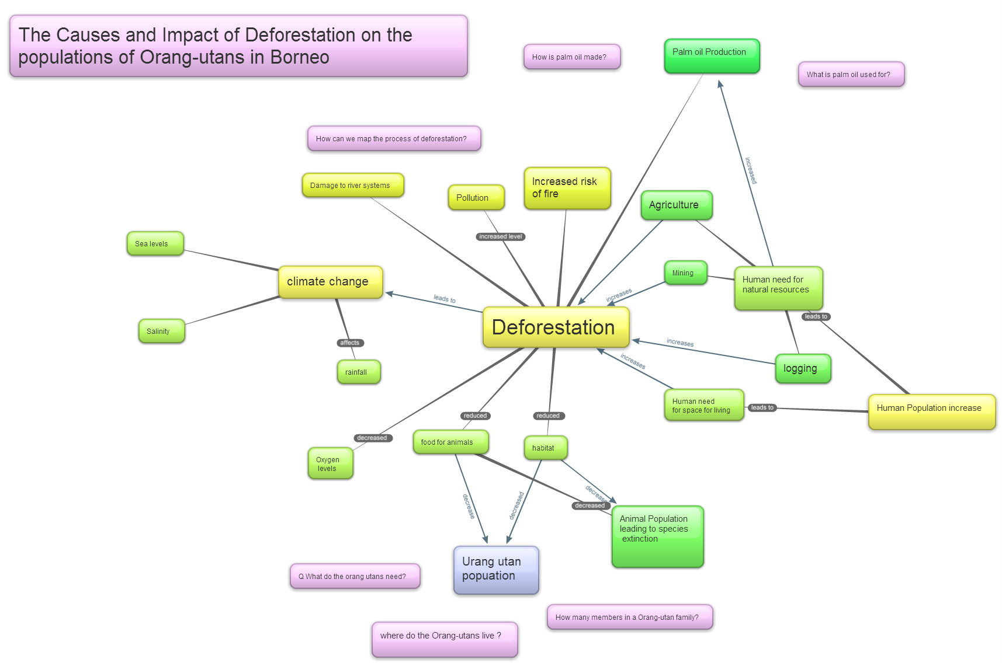
bubbl.com
Notes:
We created this in bubbl.com. This mind map is about you exploring the areas around the problem thinking about questions that you could explore and related areas. The more dense and detailed your concept map the more scope that you will have to explore.

Slide 5
Creating a Voki
Notes:
See jing video http://screencast.com/t/QqdkzYjEp

Slide 6
Creating a Mind Map
There are a number of tools available to mind map or concept map.
It is important to open at least 2 and have a play ☺

Slide 7
Mind Mapping Tools Evaluation
Website | Join & password | Ease of use | Can you import data? Format | Can you export data? Format | Other
Bubbl.us
Notes:
In the powerpoint the Bentley students will complete so that all students would get a great understanding of the different tools

Slide 8
Critique
Step 1. Set up the chairs as shown. The project creators sit in the red chairs and explain their project (no one else speaks). (5 mins)
Step 2. The Peers ask clarifying Q's requiring brief factual answers e.g. how many did you find?) (5 mins)
Step 3 The Peers ask probing Q's (longer more detailed answers e.g. How did you decide on? why have you chosen? Please can you explain ......) Leader Peer asks the Project presenters about any burning concerns they have. (5-7 mins).
Notes:
http://inquiringabouttheworld.weebly.com/support-and-critique-q--context.html

Slide 9
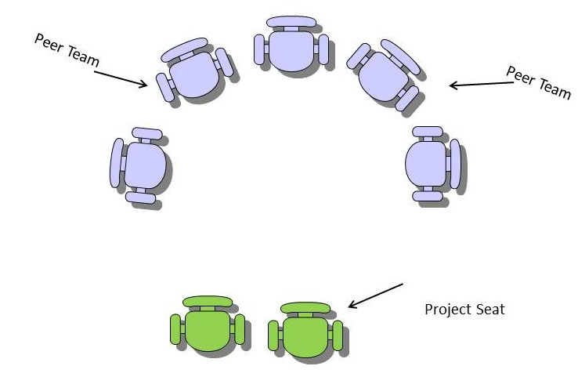
Step 4 Project presenters move back and don't speak but listen. Peers discuss the project, how they understand it and what they might suggest (kindly). (5 mins)
Step 5. Project presenters say what they have learnt from the experience and what changes they may consider making. Peers are quiet.

Slide 10
Week 3 Types of Questions and Guidance .
Clarifying - Why did you choose this voki? Can you tell me more about the problem?
Probing - How did you choose the problem? Can you explain your problem in more detail? Where are the boundaries of your problem?

Slide 11
What to assess!!! Your word document should look like this
Smith_John_12345678_IATW171_Assessment1.doc
Voki
I am Michael the monkey here in Borneo. As a member of the press I am looking at the issue of deforestation here. This is the removal of the natural forest for logging for sale, clearing land for building and industry. What is happening to the habitat of my cousins, the orang utans? What are happening to the numbers and types of animal species here on the Malaysian peninsula? I need to find out.
75 words
URL http://www.voki.com/php/viewmessage/?chsm=a9c9160f75a96b1c65df3cf5b80620ff&mId=1852155
Concept Map

Slide 12
Tasks
1) Explore how emotional bias will affect research and/or proposals around this issue. To do this choose 1 website on the emotions page and highlight use of emotive imagery and language and explain how this helps to create their message.
2) Use 1 mind mapping tools and 1 graphic organizer tools to explore 2 topics (1 tool type for each topic).
3) Create a Voki about the topic you have chosen. In 75 words explain what problem you have chosen. The Voki should identify the problem and why you have chosen it (this will form the beginning of your rationale).
4) Time to support your peers and perform a critique. Present your data to your group and get critical feedback. Critique and Support - Questions and Instructions here.
Notes:
So how are we going?

