Slide 1
Week 4
http://www.qm.qld.gov.au/Research/Biodiversity/Areas+of+research#.Uu98MfmSzT9
Notes:
http://www.qm.qld.gov.au/microsites/biodiscovery/index.html

Slide 2
Tasks
Examine all the questioning tools that have been provided for you and use them with your topic to create as many different questions as possible. Choose 3 or 4 open ended questions that will form the basis of your inquiry.
Inquiry Journey
Write 3 or 4 questions that will form the framework of your topic and lead your investigation.

Slide 3
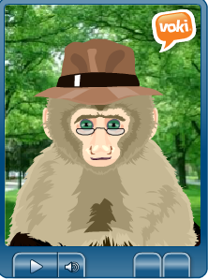
Michael the Monkey
Notes:
http://www.voki.com/php/viewmessage/?chsm=a9c9160f75a96b1c65df3cf5b80620ff&mId=1852155
This is our example as we decided in order to get you to create something we needed to do it first…..this is Michael who is a press advocate for his cousins in Borneo the Orang Utans who are impacted by deforestation

Slide 4
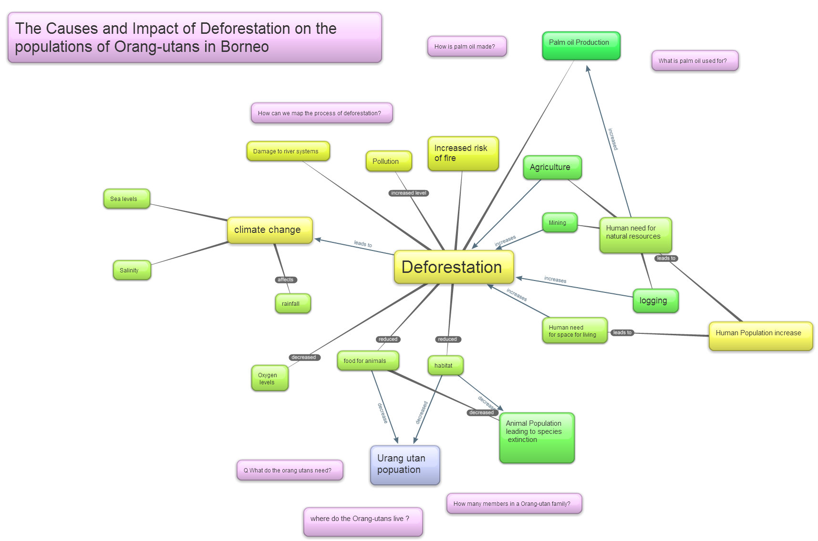
Notes:
We created this in bubbl.com. This mind map is about you exploring the areas around the problem thinking about questions that you could explore and related areas. The more dense and detailed your concept map the more scope that you will have to explore.

Slide 5
5 W’s
Who is / was responsible for deforestation of rural WA?
What are / were the reasons that deforestation occurred?
Where has deforestation had the biggest impact in rural WA?
Deforestation in rural WA
When did deforestation begin to have an environmental impact?
Why is there a need to be concerned about deforestation?

Slide 6
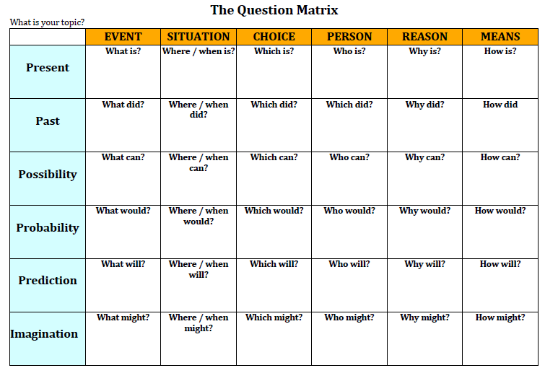
]
When did large scale cutting down of trees begin in WA?
Which activity has had the biggest impact on deforestation?
What will happen
if logging of old growth forests continues?

Slide 7
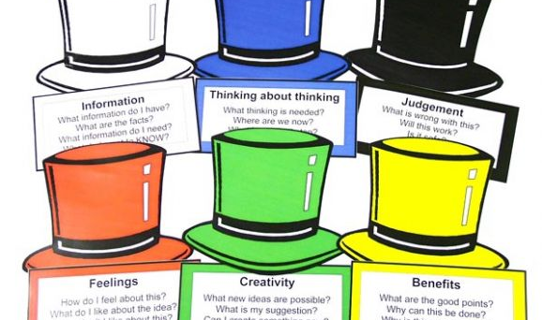
6 Thinking Hats

Slide 8
How Quickly will it dissolve?
Under what conditions will the headache tablet dissolve most quickly?

Slide 9
Who did it?
http://www.youtube.com/watch?v=7hWEBL-muFQ
Notes:
http://www.youtube.com/watch?v=7hWEBL-muFQ

Slide 10
Tasks
Examine all the questioning tools that have been provided for you and use them with your topic to create as many different questions as possible. Choose 3 or 4 open ended questions that will form the basis of your inquiry.
Inquiry in action 2. Design and complete the investigation as outlined and answer the questions.
Answer the question on Blackboard - ‘Which tool has generated the best questions for your investigation?’
Inquiry Journey
Post a list of 3 or 4 questions that will form the framework of your topic and lead your investigation.

